Slide 1
Marist Digital Education Workshop Web Scrapping Demo
Objective:
To scan through the contents of the aforementioned website link and retrieve all the workshop information which can be mailed later to the college's faculties.
Features:
Scrap the workshop information
Mail the scrapped information to the faculties
Future Tweaks – On Progress:
Increase the program ability to recognize the desired content info precisely
Create a website so that this can be managed easily
Send mails automatically based on the meeting status – available, cancelled or rescheduled
Project Repo Location: github.com/vivekVells/WebScrapMailer/tree/master/MaristDigitalEducationWorkshop Vivek Vellaiyappan Surulimuthu File last updated: March 27th 2018

Slide 2
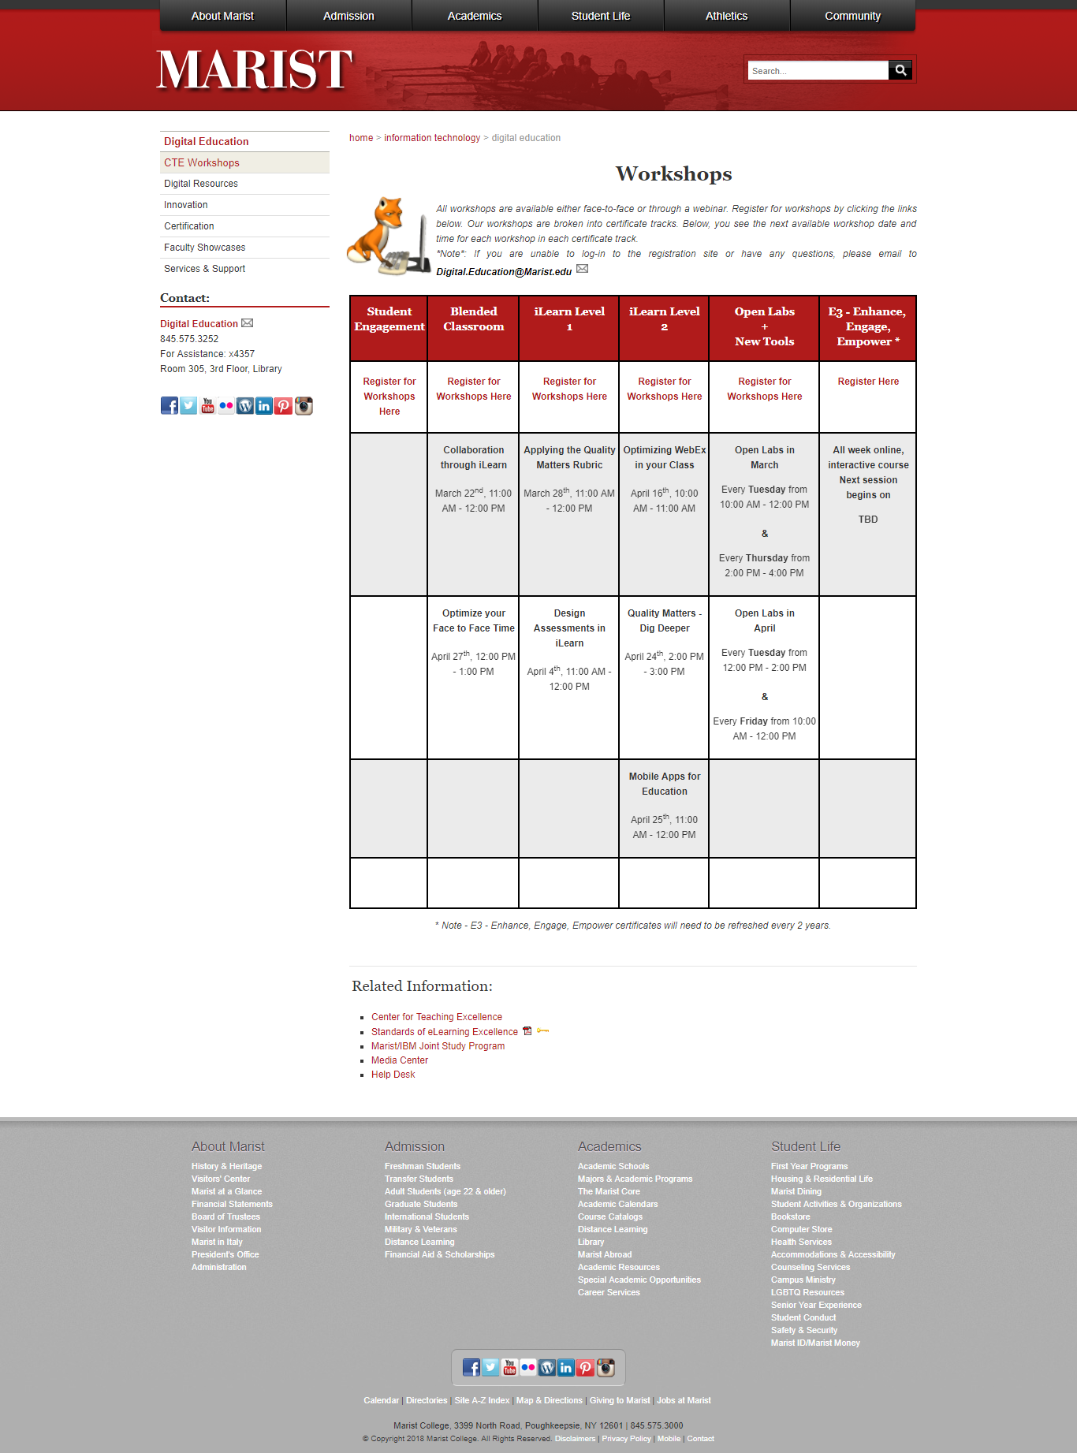
Website Page (as of March 27th 2018): https://www.marist.edu/it/digitaleducation/workshops.html

Slide 3
The workshop information we are interested in
Objective:
We are interested to retrieve the workshop information alone
To retrieve the workshop
Title
Date & Timing information
For Example:
Workshop Title: Mobile Apps for Education
Scheduled Info: April 25th, 11:00 AM - 12:00 PM

Slide 4
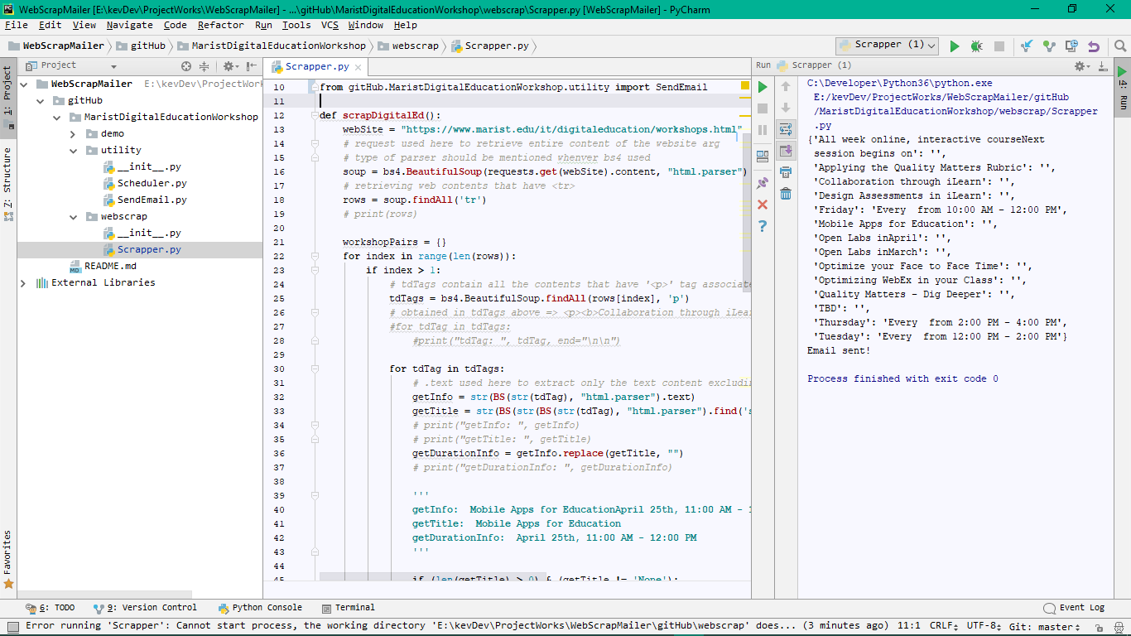
Program Execution Output

Slide 5
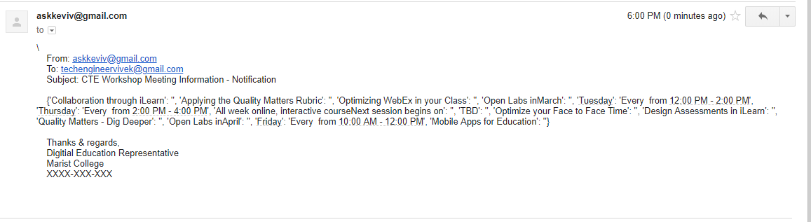
Mail Reception Output

Slide 6
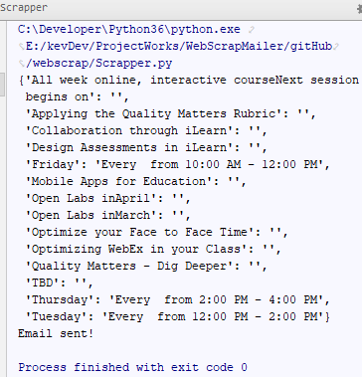
Acutal Website Content Screenshot VS Program Execution Output
Actual Website Content Screenshot
Program Execution Output
VS
Inference:
Able to retrieve the workshop title and scheduled information; but, some contents are not proper.
The content mismatch is because the website html tags usage are inconsistent

Slide 7
Thank you so much for viewing this working demo sheet. Hope you got an idea of how this application works. Highly appreciate the feedbacks if any.
Thanks & Regards,
Vivek Vellaiyappan Surulimuthu
https://github.com/vivekVells
vivekvellaiyappans@gmail.com

